Slide 1
UNIT 2

Slide 2
Constructors
A constructor is a special member function whose task is to initialize the objects of its class.
It is special because its name is same as the class name.
The constructor is invoked whenever an object of its associated class is created.
It is called constructor because it constructs the values of data members of the class.

Slide 3
Constructor - example
class add
{
int m, n ;
public :
add (void) ;
------
};
add :: add (void)
{
m = 0; n = 0;
}
When a class contains a constructor, it is guaranteed that an object created by the class will be initialized automatically.
add a ;
Not only creates the object a of type add but also initializes its data members m and n to zero.

Slide 4
Constructors
There is no need to write any statement to invoke the constructor function.
If a ‘normal’ member function is defined for zero initialization, we would need to invoke this function for each of the objects separately.
A constructor that accepts no parameters is called the default constructor.
The default constructor for class A is A : : A ( )

Slide 5
Characteristics of Constructors
They should be declared in the public section.
They are invoked automatically when the objects are created.
They do not have return types, not even void and they cannot return values.

Slide 6
Characteristics of Constructors
They cannot be inherited, though a derived class can call the base class constructor.
Like other C++ functions, Constructors can have default arguments.
Constructors can not be virtual.

Slide 7
Characteristics of Constructors
We can not refer to their addresses.
An object with a constructor (or destructor) can not be used as a member of a union.
They make ‘implicit calls’ to the operators new and delete when memory allocation is required.

Slide 8
Default Constructors
Default constructor is the constructor which doesn’t take any argument. It has no parameters.
Even if we do not define any constructor explicitly, the compiler will automatically provide a default constructor implicitly.

Slide 9
#include <iostream>
using namespace std;
class construct {
public:
int a, b;
// Default Constructor
construct()
{
a = 10;
b = 20;
}
};
int main()
{
// Default constructor called automatically
// when the object is created
construct c;
cout << "a: " << c.a << endl
<< "b: " << c.b;
return 1;
}
Output
a: 10
b: 20

Slide 10
Parameterized Constructors
It is possible to pass arguments to constructors. Typically, these arguments help initialize an object when it is created.
To create a parameterized constructor, simply add parameters to it the way you would to any other function.
When you define the constructor’s body, use the parameters to initialize the object.
The constructors can be called explicitly or implicitly.
Example e = Example(0, 50); // Explicit call
Example e(0, 50); // Implicit call

Slide 11
#include <iostream>
using namespace std;
class Point {
private:
int x, y;
public: // Parameterized Constructor
Point(int x1, int y1) {
x = x1;
y = y1;
}
int getX()
{
return x;
}
int getY()
{
return y;
}
};
int main()
{
// Constructor called
Point p1(10, 15);
// Access values assigned by constructor
cout << "p1.x = " << p1.getX() << ", p1.y = " << p1.getY();
return 0;
}
Output:
p1.x = 10, p1.y = 15

Slide 12
Uses
It is used to initialize the various data elements of different objects with different values when they are created.
It is used to overload constructors.

Slide 13
Copy Constructor
The constructor which creates an object by copying variables from another object is called a copy constructor.
Its main use is to initialize a new instance to the values of an existing instance.

Slide 14
#include<iostream>
using namespace std;
class Point
{
private:
int x, y;
public:
Point(int x1, int y1) { x = x1; y = y1; }
// Copy constructor
Point(const Point &p2) {x = p2.x; y = p2.y; }
int getX() { return x; }
int getY() { return y; }
};
int main()
{
Point p1(10, 15); // Normal constructor is called here
Point p2 = p1; // Copy constructor is called here
// Let us access values assigned by constructors
cout << "p1.x = " << p1.getX() << ", p1.y = " << p1.getY();
cout << "\np2.x = " << p2.getX() << ", p2.y = " << p2.getY();
return 0;
}
Output:
p1.x = 10, p1.y = 15 p2.x = 10, p2.y = 15

Slide 15
Static Constructor
A static constructor is used to initialize any static data, or to perform a particular action that needs to be performed once only. It is called automatically before the first instance is created or any static members are referenced.

Slide 16
Characteristic of static constructor
A static constructor does not take any access modifiers.
A static constructor does not have a parameter.
A static constructor is called automatically to initialize the class before the first instance is created or any static members are referenced.
A static constructor cannot be called directly.
The user has no control over when the static constructor is executed in the program.
A typical use of static constructors is when the class is using a log file and the constructor is used to write entries to this file.
A class can have only one static constructor.
It can access only static members of a class.

Slide 17
Overloading Constructors
Besides performing the role of member data initialization, constructors are no different from other functions. This included overloading also. In fact, it is very common to find overloaded constructors. For example, consider the following program with overloaded constructors for the figure class :
Every constructor has same name as class name but they differ in terms of either number of arguments or the datatypes of the arguments or the both.
As there is more than one constructor in class it is also called multiple constructor.

Slide 18
Overloading Constructors
A class can have more than one constructor Overloaded constructors in a class must have different parameter lists:
Rectangle(); Rectangle(double);
Rectangle(double, double);

Slide 19
#include <iostream> using namespace std; class ABC { private: int x,y;
public: ABC () //constructor 1 with no arguments
{ x = y = 0;
}
ABC(int a) //constructor 2 with one argument
{ x = y = a;
}
ABC(int a,int b) //constructor 3 with two argument
{ x = a; y = b;
}
void display()
{
cout << "x = " << x << " and " << "y = " << y << endl;
}
};
int main()
{
ABC cc1; //constructor 1
ABC cc2(10); //constructor 2
ABC cc3(10,20); //constructor 3
cc1.display(); c
c2.display();
cc3.display();
return 0; } //end of program
Output:
x = 0 and y = 0
x = 10 and y = 10
x = 10 and y = 20

Slide 20
Overloading ++ and --
Pre/post incrementing/decrementing operators
Allowed to be overloaded
Distinguishing between pre and post operators
prefix versions are overloaded the same as other prefix unary operators
d1.operator++(); // for ++d1
convention adopted that when compiler sees postincrementing expression, it will generate the member-function call
d1.operator++( 0 ); // for d1++
0 is a dummy value to make the argument list of operator++ distinguishable from the argument list for ++operator

Slide 21
Overview of C++ Overloading
Overloading occurs when the same operator or function name is used with different signatures
Both operators and functions can be overloaded
Different definitions must be distinguished by their signatures (otherwise which to call is ambiguous)
Reminder: signature is the operator/function name and the ordered list of its argument types
E.g., add(int,long) and add(long,int) have different signatures
E.g., add(const Base &) and add(const Derived &) have different signatures, even if Derived is-a Base
Most specific match is used to select which one to call

Slide 22
Overloading vs. Overriding
Overriding a base class member function is similar to overloading a function or operator
But for overriding, definitions are distinguished by their scopes rather than by their signatures
C++ can distinguish method definitions according to either static or dynamic type
Depends on whether a method is virtual or not
Depends on whether called via a reference or pointer vs. directly on an object
Depends on whether the call states the scope explicitly (e.g., Foo::baz();)

Slide 23
Function Overloading
class A {
public:
int add(int i, int j);
// not allowed, would be
// ambiguous with above:
// long add(int m, int n);
// Ok, different signature
long add(long m, long n);
};
int
main (int argc, char **argv) {
int a = 7;
int b = 8;
int c = add(a, b);
return 0;
}
Calls to overloaded functions and operators are resolved by
Finding all possible matches based on passed arguments
May involve type promotion
May involve instantiating templates
Finding the “best match” among those possible matches
Signature does not include the return type
Which might not help even if it did, i.e., calls may ignore result
So, overloading can’t be resolved by return type alone
Compiler generates an error if the call can’t be resolved

Slide 24
Operator overloading
Enabling C++’s operators to work with class objects
Using traditional operators with user-defined objects
Requires great care; when overloading is misused, program difficult to understand
Examples of already overloaded operators
Operator << is both the stream-insertion operator and the bitwise left-shift operator
+ and -, perform arithmetic on multiple types
Compiler generates the appropriate code based on the manner in which the operator is used

Slide 25
Operator overloading
Overloading an operator
Write function definition as normal
Function name is keyword operator followed by the symbol for the operator being overloaded
operator+ used to overload the addition operator (+)
Using operators
To use an operator on a class object it must be overloaded unless the assignment operator(=)or the address operator(&)
Assignment operator by default performs memberwise assignment
Address operator (&) by default returns the address of an object

Slide 26
Restrictions on Operator Overloading
C++ operators that can be overloaded
C++ Operators that cannot be overloaded

Slide 27
Restrictions on Operator Overloading
Overloading restrictions
Precedence of an operator cannot be changed
Associativity of an operator cannot be changed
Arity (number of operands) cannot be changed
Unary operators remain unary, and binary operators remain binary
Operators &, *, + and - each have unary and binary versions
Unary and binary versions can be overloaded separately
No new operators can be created
Use only existing operators
No overloading operators for built-in types
Cannot change how two integers are added
Produces a syntax error

Slide 28
Overloading Unary Operators
Overloading unary operators
Can be overloaded with no arguments or one argument
Should usually be implemented as member functions
Avoid friend functions and classes because they violate the encapsulation of a class
Example declaration as a member function:
class String { public: bool operator!() const; ... };

Slide 29
Overloading Unary Operators
Example declaration as a non-member function
class String { friend bool operator!( const String & ) ... }

Slide 30
Overloading Binary Operators
Overloaded Binary operators
Non-static member function, one argument
Example:
class String {
public:
const String &operator+=(
const String & );
...
};
y += z is equivalent to y.operator+=( z )

Slide 31
Overloading Binary Operators
Non-member function, two arguments
Example:
class String {
friend const String &operator+=(
String &, const String & );
...
};
y += z is equivalent to operator+=( y, z )

Slide 32
C++ Inheritance
One of the most important concepts in object-oriented programming is that of inheritance. Inheritance allows us to define a class in terms of another class, which makes it easier to create and maintain an application. This also provides an opportunity to reuse the code functionality and fast implementation time.
When creating a class, instead of writing completely new data members and member functions, the programmer can designate that the new class should inherit the members of an existing class. This existing class is called the base class, and the new class is referred to as the derived class.

Slide 33
C++ Inheritance
Inheritance is the process by which new classes called derived classes are created from existing classes called base classes.
The derived classes have all the features of the base class and the programmer can choose to add new features specific to the newly created derived class.

Slide 34
C++ Inheritance
Features or Advantages of Inheritance:
Reusability:
Inheritance helps the code to be reused in many situations.
The base class is defined and once it is compiled, it need not be reworked.
Using the concept of inheritance, the programmer can create as many derived classes from the base class as needed while adding specific features to each derived class as needed.

Slide 35
C++ Inheritance
Features or Advantages of Inheritance:
Saves Time and Effort:
The above concept of reusability achieved by inheritance saves the programmer time and effort. The main code written can be reused in various situations as needed.
Increases Program Structure which results in greater reliability.

Slide 36
C++ Inheritance
General Format for implementing the concept of Inheritance:
class derived_classname: access specifier baseclassname
For example, if the base class is MyClass and the derived class is sample it is specified as:
class sample: public MyClass
The above makes sample have access to both public and protected variables of base class MyClass

Slide 37
C++ Inheritance
Reminder about public, private and protected access specifiers:
1 If a member or variables defined in a class is private, then they are accessible by members of the same class only and cannot be accessed from outside the class.
2 Public members and variables are accessible from outside the class.
3 Protected access specifier is a stage between private and public. If a member functions or variables defined in a class are protected, then they cannot be accessed from outside the class but can be accessed from the derived class.

Slide 38
Type of Inheritance
When deriving a class from a base class, the base class may be inherited through public, protected or private inheritance. The type of inheritance is specified by the access- specifier.
We hardly use protected or private inheritance, but public inheritance is commonly used. While using different type of inheritance, following rules are applied:

Slide 39
Type of Inheritance
Public Inheritance: When deriving a class from a public base class, public members of the base class become public members of the derived class and protected members of the base class become protected members of the derived class. A base class's private members are never accessible directly from a derived class, but can be accessed through calls to the public and protected members of the base class.

Slide 40
Type of Inheritance
Protected Inheritance: When deriving from a protected base class, public and protected members of the base class become protected members of the derived class.
Private Inheritance: When deriving from a private base class, public and protected members of the base class become private members of the derived class

Slide 41
C++ Inheritance
Inheritance Example:
class MyClass
{ public: MyClass(void) { x=0; } void f(int n1) { x= n1*5;}
void output(void) { cout<<x; }
private: int x; };

Slide 42
C++ Inheritance
Inheritance Example:
class sample: public MyClass { public: sample(void) { s1=0; }
void f1(int n1) { s1=n1*10;}
void output(void) { MyClass::output(); cout << s1; }
private: int s1;
};

Slide 43
C++ Inheritance
Inheritance Example:
int main(void) { sample s; s.f(10); s.output(); s.f1(20); s.output(); }
The output of the above program is
50 200

Slide 44
Types of Inheritance
1. Single class Inheritance:
Single inheritance is the one where you have a single base class and a single derived class.
Class Employee
It is a Base class (super)
Class Manager
it is a sub class (derived)

Slide 45
Types of Inheritance
2. Multilevel Inheritance:
In Multi level inheritance, a class inherits its properties from another derived class.
Class A
it is a Base class (super) of B
Class B
it is a sub class (derived) of A
and base class of class C
Class C
derived class(sub) of class B

Slide 46
Types of Inheritance
3. Multiple Inheritances:
In Multiple inheritances, a derived class inherits from multiple base classes. It has properties of both the base classes.
Class A
Class B
Base class
Class C
Derived class

Slide 47
Types of Inheritance
4. Hierarchical Inheritance:
In hierarchical Inheritance, it's like an inverted tree. So multiple classes inherit from a single base class. It's quite analogous to the File system in a unix based system.
Class A
Class B
Class D
Class C

Slide 48
Types of Inheritance
5. Hybrid Inheritance:
In this type of inheritance, we can have mixture of number of inheritances but this can generate an error of using same name function from no of classes, which will bother the compiler to how to use the functions.
Therefore, it will generate errors in the program. This has known as ambiguity or duplicity.
Ambiguity problem can be solved by using virtual base classes

Slide 49
SEQUENCE DIAGRAM
A sequence diagram is used to trace the execution of a scenario in the same context as a communication diagram.
OBJECTS AND INTERACTIONS
Sequence diagram duplicates most of the semantics of the communication diagram.
It is easier to read the passing of messages in relative order.
Sequence diagrams are often better than object diagrams for capturing the semantics of scenarios early in the development
lifecycle, before the protocols of individual classes have been identified.
Lifelines and Messages
The entities of interest are written horizontally across the top of the diagram.
A dashed vertical line, called the lifeline, is drawn below each object.
These indicate the existence of the object.

Slide 50
Messages are shown horizontally.
The endpoints of the message icons connect with the vertical lines.
The notation used for messages indicates the type of message being used.
A synchronous message is shown as a solid line with a filled arrowhead.
An asynchronous message has a solid line with an open arrowhead.
A return message uses a dashed line with an open arrowhead.
A lost message(a message that does not reach its destination) appears as a synchronous message that terminates at an endpoint (a black dot).
A found message (a message whose sender is not known) appears as a synchronous message that originates at an endpoint symbol.

Slide 51
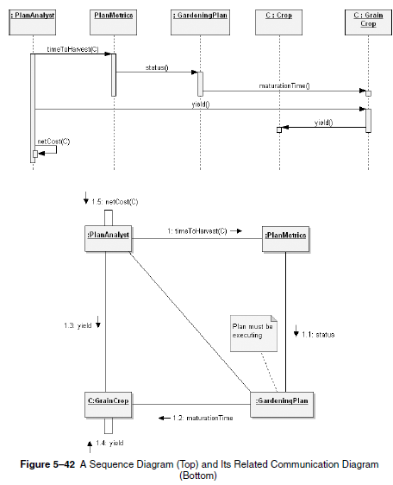

Slide 52
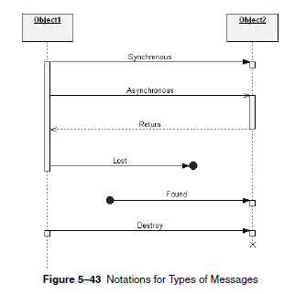

Slide 53
COMMUNICATION DIAGRAMS
Communication diagrams by their pre-UML 2.0 name-collaboration diagrams.
A communication diagram is a type of interaction diagram that focuses on how objects are linked and what messages they pass as they participate in a specific interaction.
OBJECTS, LINKS AND MESSAGES
Link may exist between two objects if and only if there is an association between their corresponding classes.
The existence of an association between two classes denotes a path of communication (i.e., a link) between instances of the
classes, whereby one object may send messages to another.

Slide 54
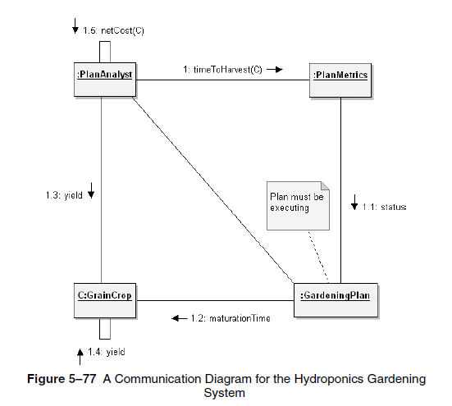
Sequence Expressions

Slide 55
The action begins with PlanAnalyst object invoking the operation timeToHarvest() on PlanMetrics.
The object C is passed as an actual argument to this operation. PlanMetrics calls status() on a certain unnamed GardeningPlan object; It includes a development note indicating that how plan is in fact executing.
The GardeningPlanobject in turn invokes the operation maturationTime() on the selectedGrainCrop object, asking for the time the crop is expected to mature.
After this selector operation completes, control then returns to the PlanAnalyst object, which then calls yield(), which in turn propagates this operation to the C:GrainCrop object.
Control again returns to the PlanAnalyst object,which completes the scenario by invoking the operation netCost() on itself.

Slide 56
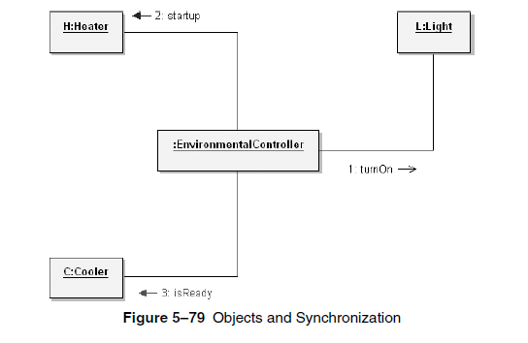
Messages and Synchronization

Slide 57
Different kinds of message synchronization that may appear in a communication diagram.
The message startup() is an example of a simple call and is represented witha directed line with a solid arrowhead. This indicates a synchronous message.
In the cases of the startup() and isReady() messages, the client must wait for the supplier to completely process the message before control can resume.
In the case of the message turnOn(), the semantics are different. This is an example of an asynchronous message, indicated by the open arrowhead.
Here the client sends the event to the supplier for processing, the supplier queues the message, and the client then proceeds without waiting for the supplier.
Asynchronous message passing is akin to interrupt handling

Slide 58
UML Interaction Diagrams
Interaction overview diagrams are a combination of activity diagrams and interaction diagrams that are intended to provide an overview of the flow of control between interaction diagram elements.
Though any type of interaction diagram (sequence, communication, or timing) may be used the sequence diagram will likely be the most prevalent.
The essential elements of the interaction overview diagram are the frames, the flow of control elements, and the interaction diagram elements.

Slide 59
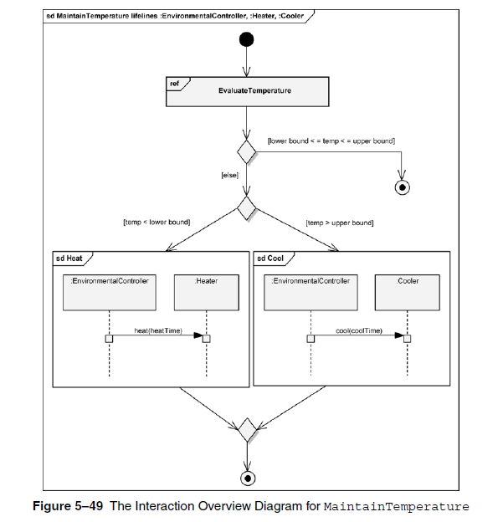

Slide 60
Frames
The interaction overview diagram is typically surrounded by a frame; however,the frame is optional when the context is clear.
In Figure, we see the surrounding frame with the name sd MaintainTemperaturelifelines :EnvironmentalController, :Heater, :Cooler in the compartment in the upper left-hand corner.
The meaning of this name is as follows:
sd: a tag that indicates this is an interaction diagram
MaintainTemperature: a name describing the purpose of the diagram
lifelines :EnvironmentalController, :Heater, :Cooler: an optional list of contained lifelines

Slide 61
Flow of Control Elements
The flow of control is provided by a combination of activity diagram elements to provide for both alternate and parallel paths.
The alternate path control is provided by combinations of a decision node, where the appropriate path is chosen, and a corresponding merge node (as appropriate) to bring the alternate paths together.This combination appears twice in Figure.
First, a decision node is used to choose a path based on whether the temperature of the Hydroponics Gardening System is within bounds (therefore, requiring no action) or out of bounds, which requires either heating or cooling.
The interaction constraint [lower bound < =temp < = upper bound] is used to choose the appropriate path. The second combination of a decision node and a merge node controls whether heating orcooling is applied by using the two interaction constraints, [temp < lowerbound] and [temp > upper bound].

Slide 62
Flow of control within parallel paths is provided by combinations of a fork node, to split into parallel paths, and a corresponding join node to bring the parallel paths together.
One important concern with parallel paths is that tokens from all paths must arrive at the join node before the flow is allowed to continue.
This requires us to ensure that, wherever an interaction constraint may block flow along a path, there is an alternate path for the token to proceed.

